Slide 1
Web Application Design
Software Design Architecture Lab # 4 Saniya Sarim

Slide 2
Web Application Design
Web application design is an important stage when building a web application. It focuses on the look and feel of the web application.
Every Application have user interface where user interacts with an application.
The design stage encompasses several different aspects, including user interface design (UI), usability (UX), content production, and graphic design. we focused mainly on UI and UX design.

Slide 3
Web Application Design
We will be using html, css, javascript for designing our webapplication
Tools we will be using in this lab are
Sublime Text ( For writing our code : you people can use any text editor like notepad++, notepad, Dreamviewer etc in order to write your web design)
Google Chrome

Slide 4
Web Application Design - HTML
What is HTML?
HTML stands for Hyper Text Markup Language
HTML describes the structure of a Web page
HTML consists of a series of elements
HTML elements tell the browser how to display the content
HTML elements are represented by tags
HTML tags label pieces of content such as "heading", "paragraph", "table", and so on
Browsers do not display the HTML tags, but use them to render the content of the page

Slide 5
Web Application Design - CSS
What is CSS?
CSS stands for Cascading Style Sheets
CSS describes how HTML elements are to be displayed on screen, paper, or in other media
CSS saves a lot of work. It can control the layout of multiple web pages all at once
External stylesheets are stored in CSS files
With CSS we can make our html design much better and makeup/decorate our web design more efficiently.

Slide 6
Web Application Design - Javascript
What is JavaScript?
JavaScript is a text-based programming language used both on the client-side and server-side that allows you to make web pages interactive. Where HTML and CSS are languages that give structure and style to web pages, JavaScript gives web pages interactive elements that engage a user. Common examples of JavaScript that you might use every day include the search box on Amazon, a news recap video embedded on The New York Times, or refreshing your Twitter feed.
Incorporating JavaScript improves the user experience of the web page by converting it from a static page into an interactive one. To recap, JavaScript adds behavior to web pages.

Slide 7
Web Application Design - Javascript
Javascript can be used for both client side and serverside scripting. As many frameworks has been developed like Node.Js etc
We in this lab will use javascript for frontend client side scripting.

Slide 8
Web Application Design
For Demonstration purpose we will design a very basic page.
First of all we will write our html that describes basic skeleton of our design.
Then we will decorate that design with CSS
Finally we will write our Javascript for making our web design interactive.

Slide 9
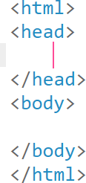
Web Application Design
All html content will be written in body tag of html

Slide 10
Web Application Design
All styling css is done in head and scripting is done in body in the end as well in head

Slide 11
Creating Basic Web Application Design Step by Step

Slide 12
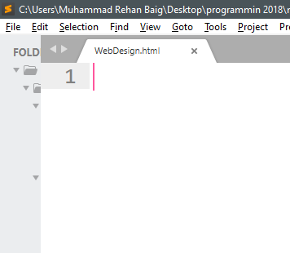
Web Application Design
Create a new file and name your file what ever you want save it with extension of .html

Slide 13
Web Application Design
Adding markup tags for making UI with Html

Slide 14
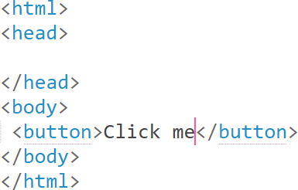
Web Application Design
Added button in our design

Slide 15
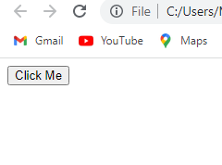
Web Application Design
Added button in our design

Slide 16

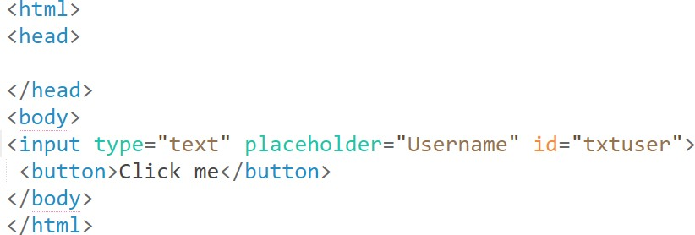
Web Application Design
Added one input as a textbox that will take username as input and assigned txtuser as id of this text box with placeholder username

Slide 17
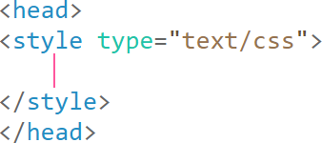
Web Application Design
Now beautifying these controls with css For styling we will add style tag in our head tag

Slide 18
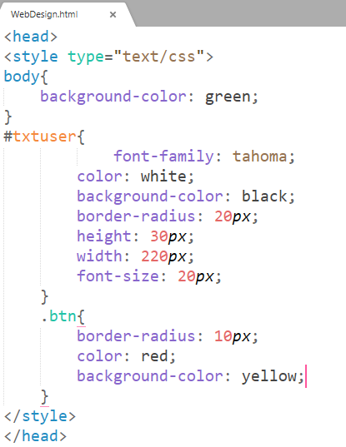
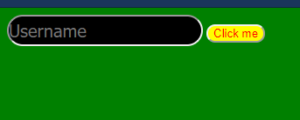
Web Application Design
Adding style for our button too we will be using class now class will be applied to all button if needed but id must be unique and specify only one control

Slide 19
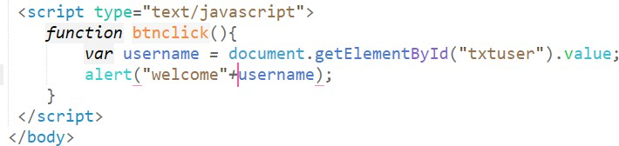
Web Application Design
Adding functionality to our web design with javascript with script tag
Basic function shows alert with text of the input that we assigned id as
txtuser

Slide 20
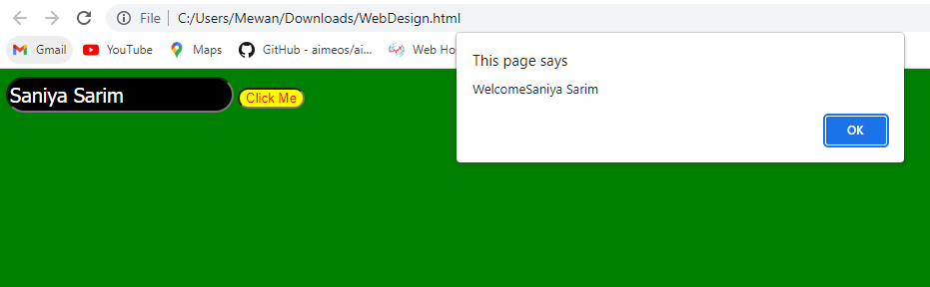
Web Application Design
Adding onclick function in our button so when button clicked it will call
btnclick function
When our button clicked the btnclick function of javascript works.
It shows the following output.

Slide 21
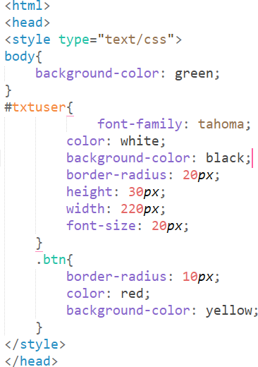
Web Application Design
Here is our complete code

Slide 22
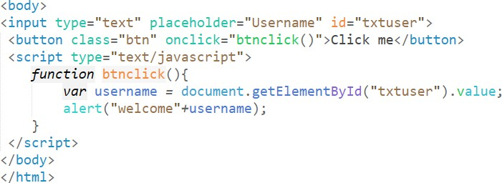
Web Application Design
Here is our complete code

Slide 23
Tasks
1. Design Facebook login page using html, css and javascript -> the page takes username and password and with javascript alert message will be displayed.

